Slide 1
Investment multiplier
Principles of Macro economics 2
ECONA- 202

Slide 2
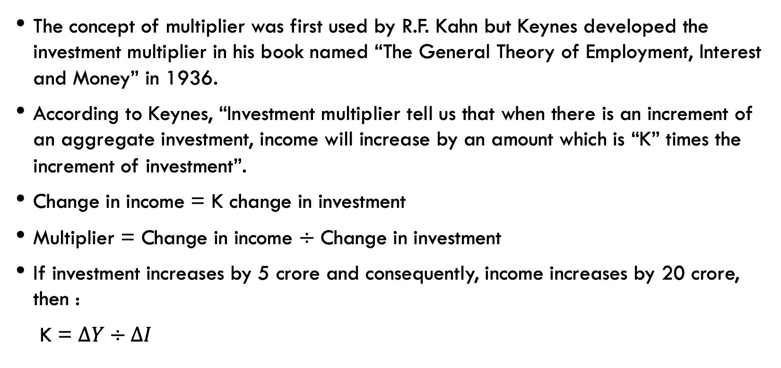
Multiplier:
The concept of multiplier was first used by R.F. Kahn but Keynes developed the investment multiplier in his book named “The General Theory of Employment, Interest and Money” in 1936.
According to Keynes, “Investment multiplier tell us that when there is an increment of an aggregate investment, income will increase by an amount which is “K” times the increment of investment”.
Change in income = K change in investment
Multiplier = Change in income $÷$ Change in investment
If investment increases by 5 crore and consequently, income increases by 20 crore, then :
K = $∆Y÷∆I$

Slide 3
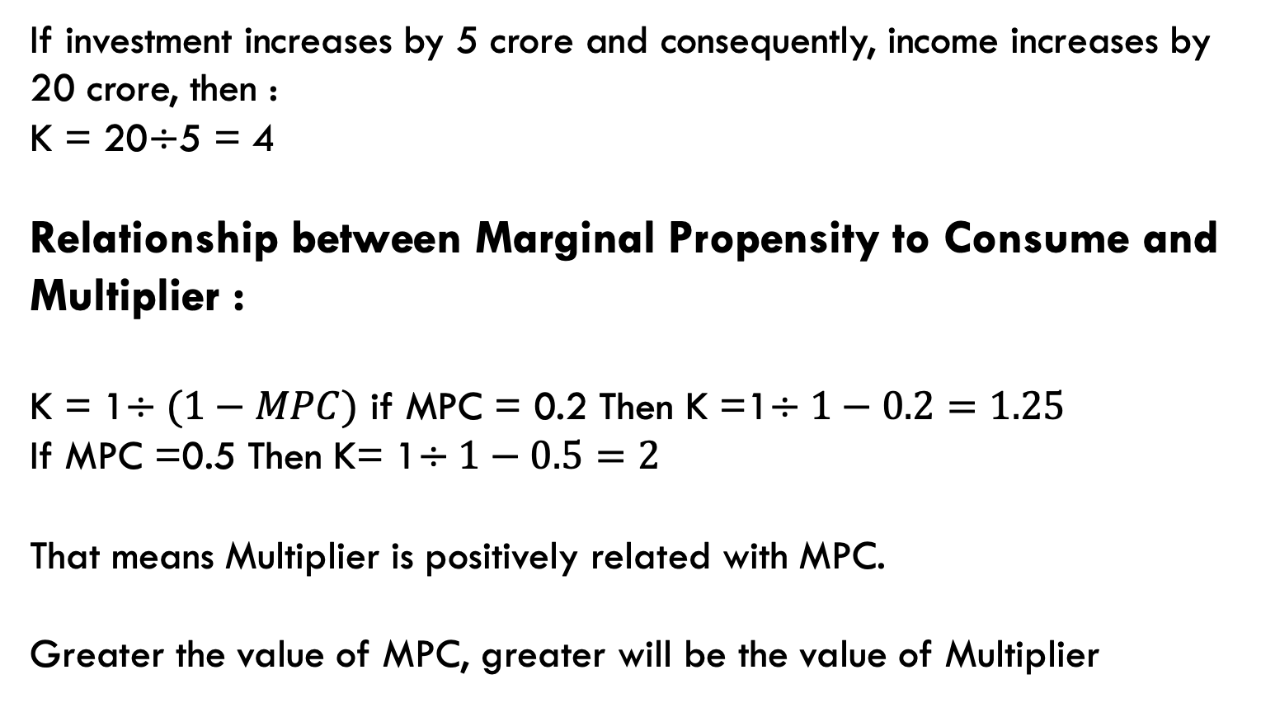
If investment increases by 5 crore and consequently, income increases by 20 crore, then :
K = 20$÷$5 = 4
Relationship between Marginal Propensity to Consume and Multiplier :
K = 1$÷(1−MPC)$ if MPC = 0.2 Then K =1$÷1−0.2=1.25$
If MPC =0.5 Then K= 1$÷1−0.5=2$
That means Multiplier is positively related with MPC.
Greater the value of MPC, greater will be the value of Multiplier

Slide 4
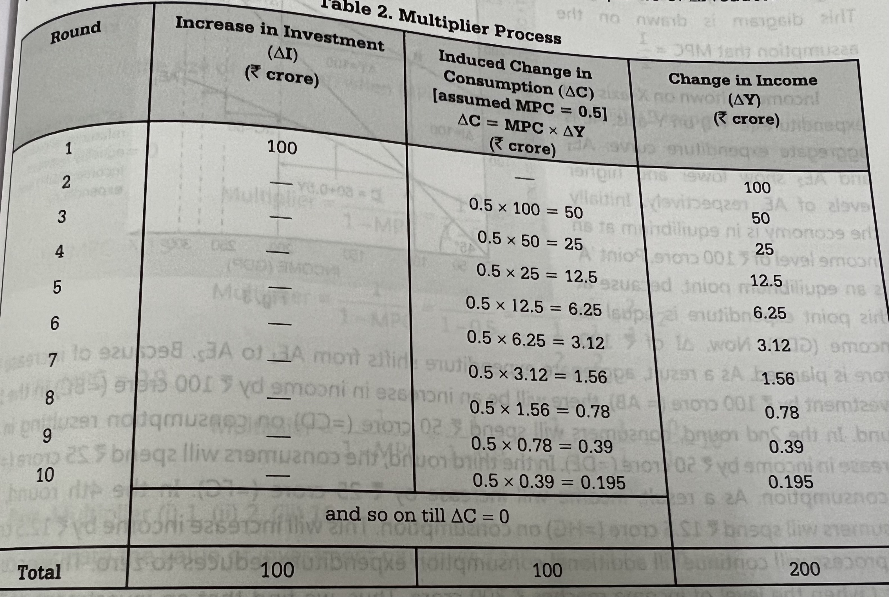
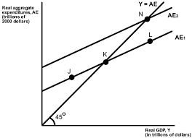

Slide 5
Forward and backward action of the multiplier :
Multiplier is a double-edged weapon. It works in the backward direction as much as in the forward direction. The process of income propagation through multiplier does not work in the forward direction only. ... The higher the MPC, the greater the value of the multiplier and greater the cumulative decline in income. In economics, a multiplier broadly refers to an economic factor that, when increased or changed, causes increases or changes in many other related economic variables. In terms of gross domestic product, the multiplier effect causes gains in total output to be greater than the change in spending that caused it.

Slide 6


